Slide 1
PID Overview
Notes:
Read the speaker notes for explanations of everything
Much of the information for this is taken from FRC Programming Done Right: https://frc-pdr.readthedocs.io/en/latest/

Slide 2
PID - Basics
What does PID stand for?
Proportional
Integral
Derivative
Notes:
PID stands for Proportional, Integral, and Derivative. The last two are calculus concepts that we will apply to make sure our motors are spinning at the right speed and/or making sure manipulators go to the right position

Slide 3
PID - Basics
What does PID Control do?
Generally used to ensure mathematically that motors are at the right speed / position
Examples include
Wrist Movement
Elevator Control
Notes:
As mentioned in the last slide, PID is used to ensure things like elevators and manipulators do not overshoot their target location, which we will call the setpoint.

Slide 4
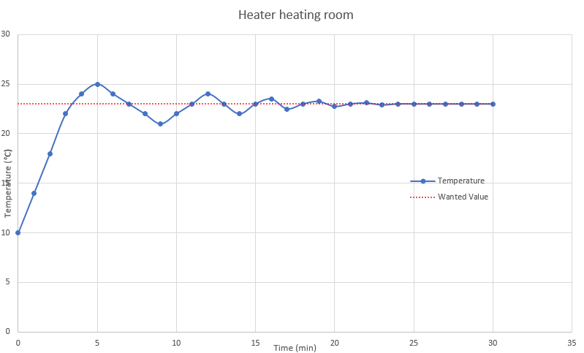
PID - Basics
Notes:
An example of PID is in a heater heating a room. Let’s say you want to say you want to heat a room from 10 degrees centigrade to 23 degrees. The heating coils take a few minutes to heat up and cool down, so when the temperature does hit 23 degrees, the temperature will overshoot until the coils cool down. But by the time the temperature decreases to the setpoint, the heating coils need to heat up again, leading to oscillation for a very long time until the setpoint is finally hit. With PID control, the furnace could have been stopped at, say, 20.5 degrees so that it would just go to the setpoint.

Slide 5
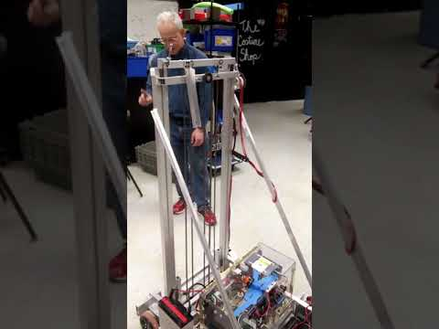
PID - Basics
Notes:
An example of PID as it applies to FIRST Robotics Competition would be controlling an elevator. Now, this team isn’t showing any kind of PID control here, however what we could have done is have it go up to a certain level so that we could, for example, go to a specified area where we need to put a game piece.

Slide 6
Equation for PID
Where error is the distance from the target
and P, I, and D are constants set prior to usage
Notes:
Now, I know this is going to shock you guys with a lot of math but trust me, this is all way easier than it looks. We’ll break down this equation and show you how PID works. As the slide says, error is the distance from our setpoint

Slide 7
PID - Proportional
P * error
Breaking force is applied proportional to the distance from the target
Example: Applying more breaking force the closer a car is to a stop sign
Notes:
The first and simplest part of PID is proportional. All it is is the P constant (I’ll show you how to set constants later) times the error. Imagine you’re in a car, and you’re applying more breaking force the closer you are to the stop sign. That’s essentially what proportional control is

Slide 8
PID - Proportional
Using only proportional is possible, primarily meant for slow moving or imprecise mechanisms
Proportional alone can lead to oscillation as it overshoots and overcompensates
Notes:
While you can use only proportional control, you can only really do this if it’s a slow moving mechanism or if precise movement is really not a necessity. Using proportional alone can lead to oscillation as the system overshoots and attempts to compensate, so while it’s better than no control loop it’s still not great.

Slide 9
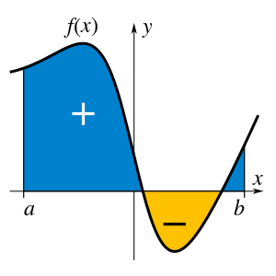
PID - Integral
I * ∑error
Integral is area under a curve
Can fix issues with oscillation
Sum of past error levels
Notes:
The next part

Slide 10
PID - Integral
Integral is sum of all past error
Gain increases more and more the longer the motor is not in position
Most devices can use P and I alone
Can take a while to set into position, making it not ideal for ultra precision manipulators

Slide 11
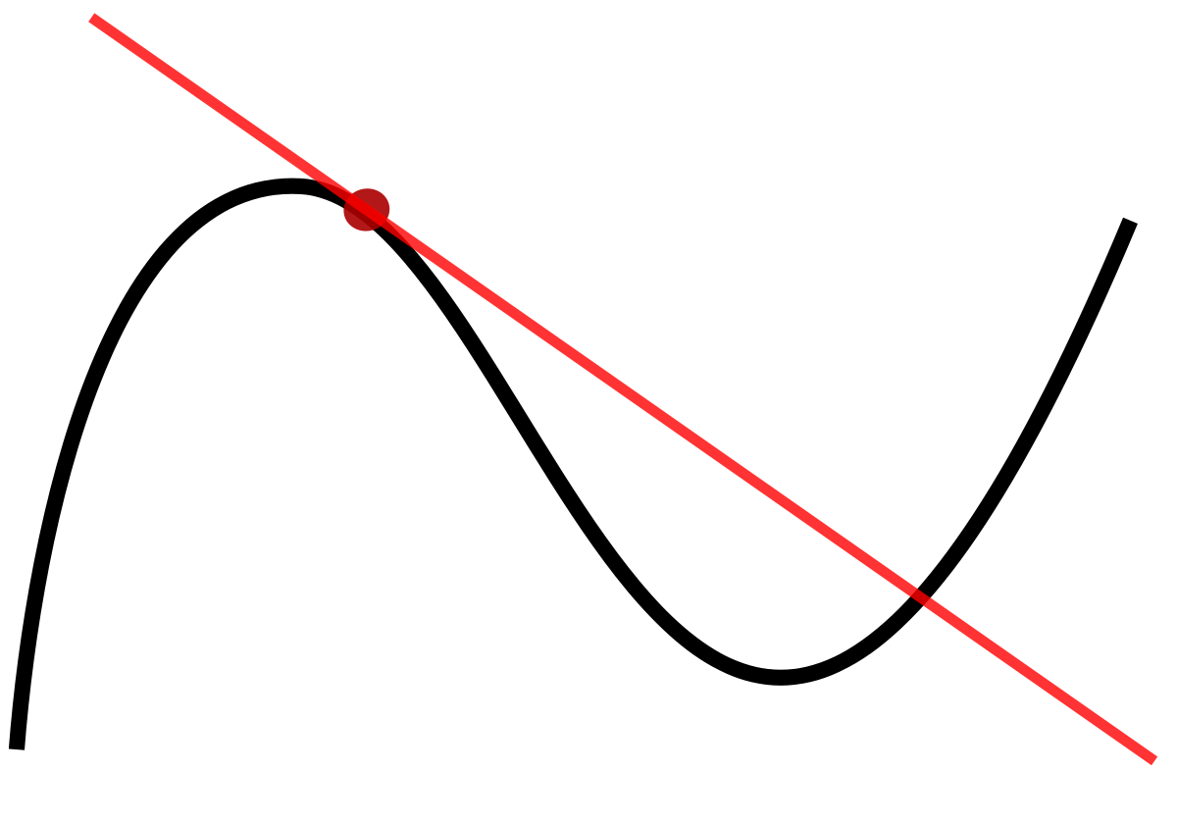
PID - Derivative
D * (δerror / δtime)
Derivative is slope of line at a given point
Calculates change in error over time

Slide 12
PID - Derivative
Change in error over time can be used to predict future system behavior
Useful if it is imperative that we don’t overshoot, but overkill for most manipulators
Useful if we have issues with settling times with PI control

Slide 13
PID - Feed-forward
Essential for a good control loop
Feedforward accounts for known dynamics of a system (ie weight)
Feedback accounts for unexpected changes like changes in weight or friction

Slide 14
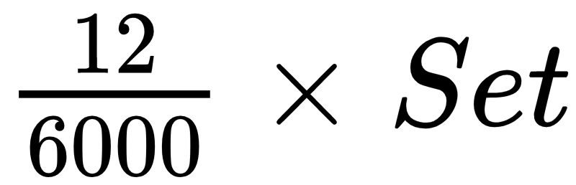
Example Feed-Forward Equation
Where Set[point] is the speed we want to set the motor to
Notes:
If we pretend that we have a motor that, when given 12 volts of power will run at 6000 RPM then we can simply put that as 12/6000 * whatever setpoint, the setpoint being whatever speed we want to run the motor at, and then that would be our feed forward

Slide 15
PID - Setting the Constants
I saw in the equation the constants P, I, and D. How do we set those?
This process is called tuning
Most common process is called Zieger-Nicholas (don’t need to remember the name)

Slide 16
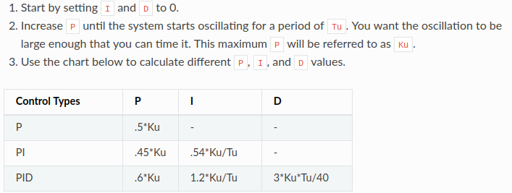
PID - Setting the Constants

Slide 17
PID - PIDSubsystem Class
So how do I actually use this in code?
Create a new class that extends PIDSubsystem
Create required methods:
Constructor
returnPIDOutput, usePIDOutput, initDefaultCommand
Notes:
API Reference: https://bit.ly/2HUsjzd

Slide 18
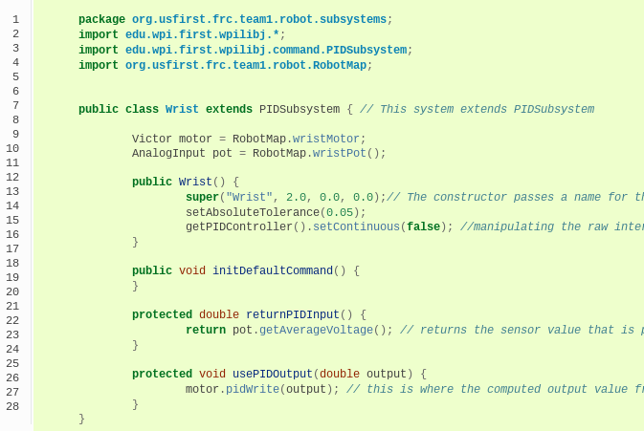
PID - PIDSubsystem Class
Note: Extending a class brings in all the methods it has

Slide 19
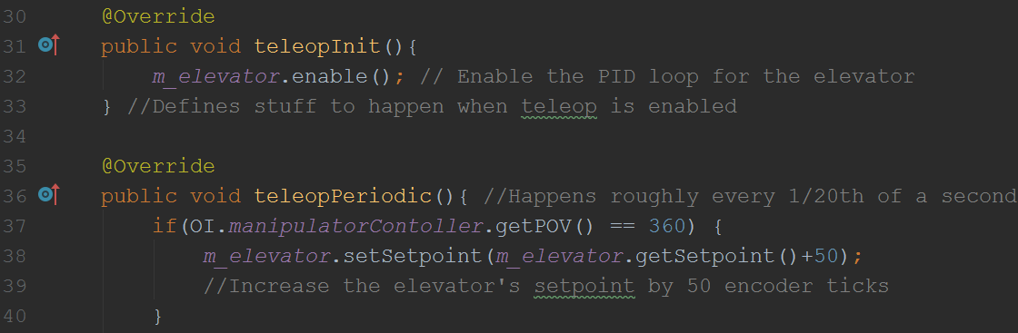
PID - PIDSubsystem Class
Note: m_elevator is our PIDSubsystem here
Actually telling the loop to bring up the elevator in Robot.java

